Slide 1
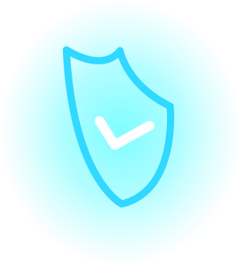

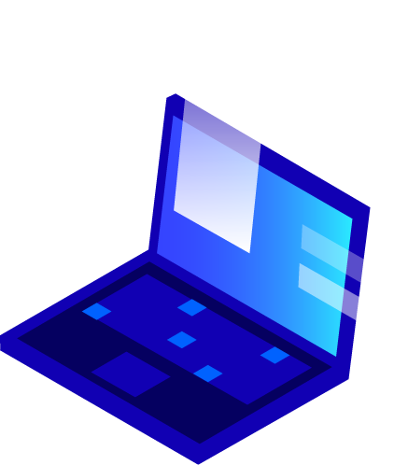


CYBERSECURITY
Protecting Our Digital World
A Presentation By : HACKERSPOT

Slide 2
Hello!
I am HackerSpot…
I am here because I love to give presentations.
You can find me at https://hackerspot.org.in

Slide 3
Title Slide
Title : Cybersecurity: Protecting Our Digital World
Subtitle : Understanding Threats, Defenses, and Best Practices
Presenter : HackerSpot
Date : [Current Date]

Slide 4
Table of Contents
What is Cybersecurity?
Why is Cybersecurity Important?
Common Cyber Threats
Impact of Cyberattacks
Key Cybersecurity Principles
Types of Cybersecurity
Cybersecurity Best Practices (Individual)
Cybersecurity Best Practices (Organizational)
Future of Cybersecurity
Q&A

Slide 5
What is Cybersecurity?
Definition : Cybersecurity refers to the practice of protecting systems, networks, and programs from digital attacks.
Purpose : These cyberattacks are usually aimed at accessing, changing, or destroying sensitive information; extorting money from users; or interrupting normal business processes.
Scope : It involves technologies, processes, and controls designed to protect digital assets from cyber threats.

Slide 6
Why is Cybersecurity Important?
Protecting Sensitive Data : Safeguarding personal, financial, and confidential information.
Maintaining Trust : Ensuring the integrity and availability of digital services and systems.
Preventing Financial Loss : Avoiding costly data breaches, system downtime, and regulatory fines.
Ensuring Business Continuity : Protecting critical infrastructure and operations from disruption.
Safeguarding National Security : Protecting critical government and military systems.

Slide 7
Common Cyber Threats
Malware : Malicious software (e.g., viruses, worms, trojans, ransomware, spyware).
Phishing : Deceptive attempts to acquire sensitive information (e.g., usernames, passwords, credit card details) by disguising as a trustworthy entity in electronic communication.
Denial-of-Service (DoS/DDoS) Attacks : Overwhelming a system's resources to make it unavailable to legitimate users.
Man-in-the-Middle (MitM) Attacks : Intercepting communication between two parties to eavesdrop or alter messages.
SQL Injection : Exploiting vulnerabilities in databases to gain unauthorized access or manipulate data.
Zero-Day Exploits : Attacks that target software vulnerabilities that are unknown to the vendor.

Slide 8
Impact of Cyberattacks
Financial Loss : Direct theft, recovery costs, legal fees, regulatory fines.
Reputational Damage : Loss of customer trust, negative public perception.
Operational Disruption : Downtime, interruption of critical services, business paralysis.
Data Loss/Theft : Compromise of sensitive personal, financial, or intellectual property.
Legal & Regulatory Consequences : Non-compliance penalties, lawsuits.
Erosion of Trust : Damage to individual and societal confidence in digital systems.

Slide 9
Key Cybersecurity Principles
Confidentiality : Protecting information from unauthorized access.
Integrity : Ensuring information is accurate, complete, and protected from unauthorized modification.
Availability : Ensuring authorized users have timely and reliable access to information and systems.
Authentication : Verifying the identity of users or systems.
Non-Repudiation : Proving that a specific action or event has occurred and cannot be denied.

Slide 10
Types of Cybersecurity
Network Security : Protecting computer networks from intruders.
Application Security : Protecting software and devices from threats during and after development.
Information Security : Protecting data in all its forms (digital and physical).
Operational Security : Protecting operational processes and decisions.
Cloud Security : Protecting data, applications, and infrastructure involved in cloud computing.
Mobile Security : Protecting mobile devices and their data.
IoT Security : Securing Internet of Things devices and their connections.

Slide 11
Cybersecurity Best Practices (Individual)
Strong, Unique Passwords : Use complex passwords and a password manager.
Two-Factor Authentication (2FA) : Add an extra layer of security to your accounts.
Be Wary of Phishing : Don't click suspicious links or open unsolicited attachments.
Keep Software Updated : Patch operating systems and applications regularly.
Use Antivirus/Anti-Malware Software : Scan your devices for threats.
Backup Your Data : Regularly backup important files to an external drive or cloud.
Be Careful on Public Wi-Fi : Avoid sensitive transactions on unsecured networks.
Educate Yourself : Stay informed about current cyber threats.

Slide 12
Cybersecurity Best Practices (Organizational)
Risk Assessment & Management : Identify, assess, and mitigate cybersecurity risks.
Employee Training : Regularly train employees on cybersecurity awareness and best practices.
Access Control : Implement the principle of least privilege.
Endpoint Security : Secure all devices connected to the network.
Incident Response Plan : Develop and test a plan for responding to cyber incidents.
Data Encryption : Encrypt sensitive data at rest and in transit.
Regular Audits & Penetration Testing : Identify vulnerabilities proactively.
Vendor Risk Management : Assess the security posture of third-party vendors.
Network Segmentation : Divide networks to limit the spread of attacks.

Slide 13
Future of Cybersecurity
AI and Machine Learning: Enhancing threat detection and response.
Quantum Computing: New challenges and opportunities for cryptography.
Blockchain Technology: Potential for secure data management and authentication.
Threat Intelligence Sharing: Collaborative efforts to combat cybercrime.
Increased Regulatory Scrutiny: Stricter data protection laws.
Human Factor: Continued emphasis on cybersecurity education and awareness.

Slide 14

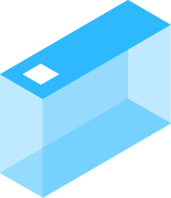



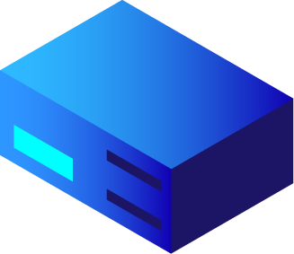



Data Base Management Systems
A Database Management System (DBMS) is software that helps users store, organize, retrieve, and manage data efficiently. It's like a structured digital filing system that ensures data is accessible, secure, and easy to manipulate.

Slide 15

CryptoGraphy :
Cryptography is the science of securing information by converting it into an unreadable format that can only be deciphered by authorized parties. It's the backbone of data security, ensuring confidentiality, integrity, and authentication in digital communication.

Slide 16
Networking
Networking refers to the process of connecting and communicating between computers and other devices to share resources, exchange data, and enable digital interactions. It's the backbone of modern internet and cybersecurity.
Key Concepts in Networking:
Nodes & Devices: Computers, servers, routers, and switches involved in communication.
Protocols: Rules governing data transmission (e.g., TCP/IP, HTTP, FTP).
IP Addressing: Identifiers for devices on a network, enabling data routing.
Packets & Routing: Data is sent in small chunks (packets) through optimized paths.

Slide 17
Cyber Thraet Maps

Slide 18
CIA Triad
Confindentiality
Ensuring that data is only accessible to authorized users. Techniques like encryption, access control, and authentication help maintain confidentiality.
1
Integrity
Guaranteeing that data is accurate and unaltered. Hashing, digital signatures, and checksums help prevent unauthorized modifications.
2
Availability
Ensuring that data and systems are accessible when needed. Measures like redundancy, load balancing, and disaster recovery help maintain availability.
3

Slide 19

Mobile Security
Threats: Malware, phishing, SIM swapping, insecure apps, public Wi-Fi risks.
Protection Measures:
  Use biometric authentication (fingerprint, facial recognition).
  Enable device encryption to protect stored data.
  Install apps only from official stores (Google Play, Apple App Store).
  Use VPNs for secure internet browsing.
  Keep OS and apps updated to patch vulnerabilities.

Slide 20

Tablet Security
Threats: Similar to mobile devices, but also risks from shared usage, app permissions, and weaker security settings.
Protection Measures:
  Use strong passwords/MFA for accounts.
  Limit app permissions to prevent unnecessary access.
  Secure Wi-Fi connections and avoid public networks.
  Regularly clear cache and browsing history to remove sensitive data.
  Install device management apps for tracking and remote wipe options.

Slide 21

Computer Security
Threats: Ransomware, phishing, system exploits, remote access attacks.
Protection Measures:
  Install antivirus and endpoint security software.
  Enable firewalls and configure security settings.
  Keep operating system and software updated.
  Use strong passwords and a password manager.
  Backup data regularly to prevent loss from cyberattacks.

Slide 22

Thanks!
Any questions?
You can find me at : bablunannam@gmail.com
Hackerspot.org.in

Slide 23
THE END…

